Slide 1
Explicit lyrics and
Spotify streaming performance
Does the relationship differ across genres?
BUAD 312 Midterm Project
Consulting analysis for Universal Music
[Team name]
[Name 1] [Name 2] [Name 3] [Name 4] [Name 5] [Name 6]
Notes:
Suggested presenter: Person 1. Introduce all six team members and the consulting role.
Sources: /Users/sonlynguyen/Documents/BUAD312/Midterm Project/tracks_simplified.csv; /Users/sonlynguyen/Documents/BUAD312/Midterm Project/Midterm Official R Script.R. Analysis refreshed October 11, 2026. All model results use the current official script's ordinary lm() standard errors unless explicitly labeled as a separate robust check.

Slide 2
Research question and business context
Does explicitness relate to streams differently across genres, after accounting for artist and song characteristics?
Business use
Comparison
Help Universal evaluate catalog performance within the appropriate genre context.
Explicit versus non-explicit tracks within each genre. The outcome is recorded streams per track.
The analysis estimates associations. It does not establish the effect of changing lyrics.
02
Notes:
Suggested presenter: Person 1.
State the exact question and explain why catalog evaluation may benefit from genre context. Compare tracks within genres. This is observational data, so results do not measure what would happen if a label edited the lyrics of the same song. Suggested discussion: which promotion decisions could this evidence help investigate?
Sources: /Users/sonlynguyen/Documents/BUAD312/Midterm Project/tracks_simplified.csv; /Users/sonlynguyen/Documents/BUAD312/Midterm Project/Midterm Official R Script.R. Analysis refreshed October 11, 2026. All model results use the current official script's ordinary lm() standard errors unless explicitly labeled as a separate robust check.

Slide 3
Data and cleaning decisions
5,870
5,824
46
Original tracks
Tracks in the models
Rows excluded
Cleaning
Model preparation
Exclude invalid durations and missing model inputs. Convert dates to release years. Keep large stream counts in the main model.
Use natural log of streams. Treat genre and explicitness as categories. Compare every model on the same sample.
03
Notes:
Suggested presenter: Person 2.
All models use the same 5,824 rows. The original CSV contains 5,870 distinct track IDs. The excluded rows comprise 17 zero-duration tracks and 29 additional tracks missing follower information. Release dates mix M/D/YY, YYYY, and YYYY-MM. The script extracts the year and uses grouped release periods. Missing artist names do not trigger exclusions. The dataset has releases through 2021 and no documented stream-count observation window. Explain why log streams is used and show the original distribution if asked.
Sources: /Users/sonlynguyen/Documents/BUAD312/Midterm Project/tracks_simplified.csv; /Users/sonlynguyen/Documents/BUAD312/Midterm Project/Midterm Official R Script.R. Analysis refreshed October 11, 2026. All model results use the current official script's ordinary lm() standard errors unless explicitly labeled as a separate robust check.

Slide 4
Explicit-song representation varies by genre
Number of tracks in the modeling sample
Some comparisons have small explicit groups: Electronic/Dance = 11 and Soul/R&B = 5.
04
Notes:
Suggested presenter: Person 3.
Native chart uses counts from the cleaned modeling sample, not the full raw dataset. Hip-Hop/Rap contains 865 explicit and 359 non-explicit tracks. Electronic/Dance contains only 11 explicit tracks and Soul/R&B only five. A larger group can have greater total streams purely because it contains more songs. Our comparisons instead use per-track summaries and regression.
Sources: /Users/sonlynguyen/Documents/BUAD312/Midterm Project/tracks_simplified.csv; /Users/sonlynguyen/Documents/BUAD312/Midterm Project/Midterm Official R Script.R. Analysis refreshed October 11, 2026. All model results use the current official script's ordinary lm() standard errors unless explicitly labeled as a separate robust check.

Slide 5
Median streams show different within-genre patterns
Median recorded streams per track, before adjusting for other variables
These descriptive differences motivate the regression. They do not isolate explicitness.
05
Notes:
Suggested presenter: Person 3.
These are unadjusted medians and not regression estimates. Main examples: Hip-Hop/Rap explicit median 31,219 versus non-explicit 24,395; Latin explicit 19,901 versus non-explicit 30,737; Pop explicit 23,721 versus non-explicit 13,271. Describe the observed differences, then transition to controlling for other characteristics. Median values appear rounded to whole streams.
Sources: /Users/sonlynguyen/Documents/BUAD312/Midterm Project/tracks_simplified.csv; /Users/sonlynguyen/Documents/BUAD312/Midterm Project/Midterm Official R Script.R. Analysis refreshed October 11, 2026. All model results use the current official script's ordinary lm() standard errors unless explicitly labeled as a separate robust check.

Slide 6
Regression models and explanatory power
Model | R² | Adjusted R²
1. Explicitness only | 2.38% | 2.37%
2. Genre and controls | 11.91% | 11.53%
3. Explicitness × genre + controls | 12.36% | 11.89%
All models: 5,824 tracks. Outcome: natural log of streams.
The interaction model explains 12.36% of variation in log streams. Most variation remains unexplained.
06
Notes:
Suggested presenter: Person 4.
All three models use log(streams), the same rows, and ordinary least squares. Controls are log(artist_followers+1), artist_popularity, duration_min, release_period, release_size, empty_markets, danceability, energy, valence, acousticness, speechiness, liveness, instrumentalness, loudness, and tempo. Model 3 adds explicit-by-genre interactions to model 2. Adding those interactions raises R-squared by about 0.45 percentage points. R-squared refers to all predictors together and is in-sample. It is not the fraction caused by lyrics or a forecast accuracy measure.
Full formula: log_streams ~ explicit * genres + log_followers + artist_popularity + duration_min + release_period + release_size + empty_markets + danceability + energy + valence + acousticness + speechiness + liveness + instrumentalness + loudness + tempo
Sources: /Users/sonlynguyen/Documents/BUAD312/Midterm Project/tracks_simplified.csv; /Users/sonlynguyen/Documents/BUAD312/Midterm Project/Midterm Official R Script.R. Analysis refreshed October 11, 2026. All model results use the current official script's ordinary lm() standard errors unless explicitly labeled as a separate robust check.

Slide 7
The fitted explicit association differs by genre
Selected within-genre coefficients, controlling for the included variables
Overall interaction test
p = 0.0000458
Evidence that the relationship varies across genres in this sample.
Horizontal axis: difference in predicted log streams. Individual uncertainty appears in the appendix.
07
Notes:
Suggested presenter: Person 5.
The selected bars show within-genre coefficients from model 3. They are differences in predicted natural-log streams. A positive coefficient indicates a higher fitted log-stream outcome for explicit tracks; a negative coefficient indicates a lower fitted outcome. The combined F-test is anova(model2, model3), with six interaction degrees of freedom, F = 4.9527, p = 0.00004581. The overall test concerns equality across all seven genres; it does not establish significance for each genre. The appendix reports all seven estimates and multiplicity-adjusted p-values. The main graph displays point estimates without confidence intervals.
Sources: /Users/sonlynguyen/Documents/BUAD312/Midterm Project/tracks_simplified.csv; /Users/sonlynguyen/Documents/BUAD312/Midterm Project/Midterm Official R Script.R. Analysis refreshed October 11, 2026. All model results use the current official script's ordinary lm() standard errors unless explicitly labeled as a separate robust check.

Slide 8
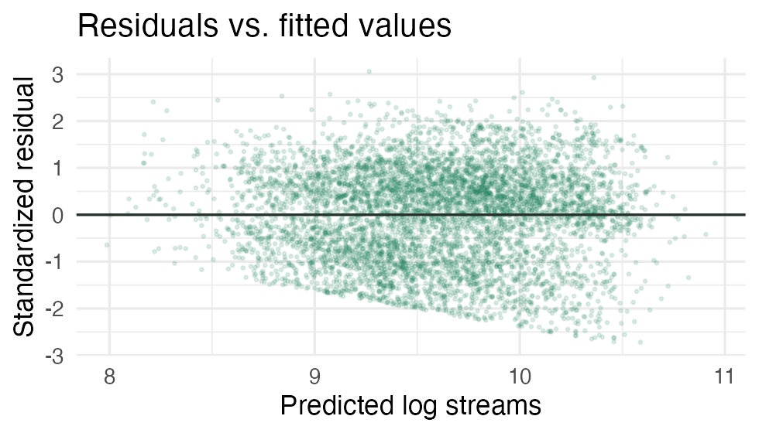
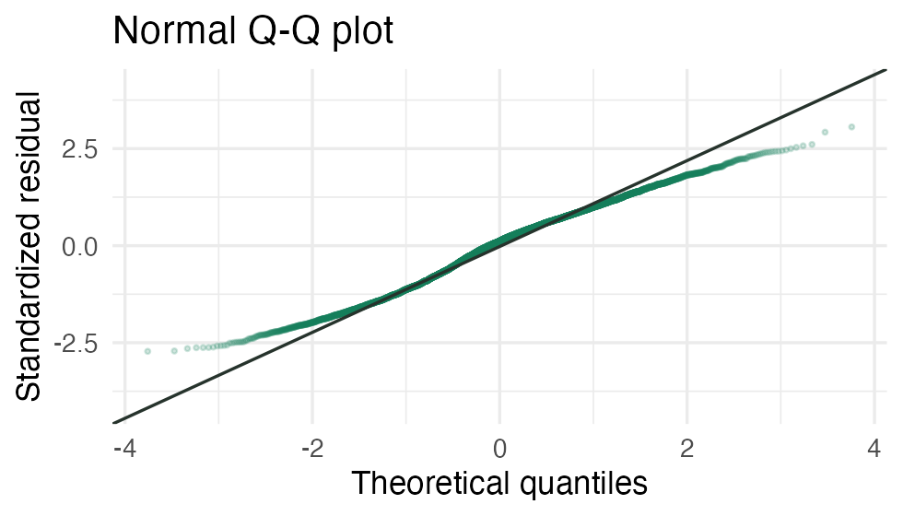
Diagnostics and sensitivity limit the conclusion
Unequal residual spread
Latin result changes with the sample
Ordinary p-values need caution. A separate robust check still supports the overall interaction.
With markets listed only (n = 3,659), its ordinary p-value is 0.080.
08
Notes:
Suggested presenter: Person 6.
The residual plots depart from constant variance and normality. A separate Breusch-Pagan audit gives p < 2.2e-16 for constant variance. A separate HC3 robust joint interaction test gives p = 0.00004227682378949, so the overall interaction remains supported under that check. Robust inference still assumes independent rows; repeated artists may violate independence and most artist names are missing. The official script uses ordinary standard errors. Its Latin coefficient changes from -0.614 to -0.348 in the markets-listed sample, and its ordinary p-value becomes 0.080. The earlier robust Latin restricted-sample p-value was about 0.116. Avoid mixing these methods in one results table.
Sources: /Users/sonlynguyen/Documents/BUAD312/Midterm Project/tracks_simplified.csv; /Users/sonlynguyen/Documents/BUAD312/Midterm Project/Midterm Official R Script.R. Analysis refreshed October 11, 2026. All model results use the current official script's ordinary lm() standard errors unless explicitly labeled as a separate robust check.

Slide 9
Recommendations and additional data
Use genre context
Review explicit and non-explicit tracks within comparable genres and artist profiles.
Test version and promotion strategies
Compare paired clean and explicit releases with comparable timing and promotion before changing policy.
Collect the missing information
Playlist exposure, marketing spend, listener geography, artist IDs, and streams measured over the same time window.
09
Notes:
Suggested presenter: Person 6.
Frame these as proposals for discussion, not demonstrated causal effects. The dataset does not compare randomized clean and explicit versions of the same recording. A useful next study could compare paired versions with comparable release timing and promotion, or randomize promotional exposure where feasible. Obtain a fixed streaming observation window, playlist exposure, marketing spend, listener geography and artist identifiers. Suggested closing: our results justify testing genre-specific strategies, while uncertainty prevents a universal rule about changing lyrics.
Sources: /Users/sonlynguyen/Documents/BUAD312/Midterm Project/tracks_simplified.csv; /Users/sonlynguyen/Documents/BUAD312/Midterm Project/Midterm Official R Script.R. Analysis refreshed October 11, 2026. All model results use the current official script's ordinary lm() standard errors unless explicitly labeled as a separate robust check.

Slide 10
Appendix: genre estimates and uncertainty
Genre | Log coeff. | 95% interval | p-value | Holm p | Explicit n
Hip-Hop/Rap | 0.199 | 0.037 to 0.362 | 0.0162 | 0.0811 | 865
Latin | -0.614 | -0.929 to -0.299 | 0.000134 | 0.000939 | 92
Pop | 0.215 | -0.006 to 0.436 | 0.0565 | 0.2261 | 147
Electronic/Dance | 1.099 | 0.313 to 1.886 | 0.0061 | 0.0368 | 11
Rock/Metal | -0.035 | -0.604 to 0.534 | 0.9032 | 1.0000 | 21
Soul/R&B | -0.255 | -1.445 to 0.934 | 0.6739 | 1.0000 | 5
Other/Unknown | 0.158 | -0.015 to 0.331 | 0.0739 | 0.2261 | 265
Ordinary lm() inference. Holm adjusts seven comparisons. All genres share model R² = 0.1236.
10
Notes:
Suggested presenter: Person 5 / discussion.
All values come from the current official script. Coefficients and intervals are in natural-log-stream units. The intervals and raw p-values use ordinary lm() standard errors. Holm p-values adjust the seven within-genre tests. Hip-Hop/Rap has raw p = 0.0162 but Holm p = 0.0811. Pop has raw p = 0.0565 and is not significant at 0.05 using this method. Small explicit groups make Electronic/Dance and Soul/R&B comparisons fragile. The point estimates remain the same if robust standard errors are used, but intervals and p-values change. This appendix is useful for questions and can remain outside the spoken presentation.
Sources: /Users/sonlynguyen/Documents/BUAD312/Midterm Project/tracks_simplified.csv; /Users/sonlynguyen/Documents/BUAD312/Midterm Project/Midterm Official R Script.R. Analysis refreshed October 11, 2026. All model results use the current official script's ordinary lm() standard errors unless explicitly labeled as a separate robust check.

